Slide 1


Slide 2


Introduction to R Programming
Marek Strejczek
Senior Architect
CPP Maps, Automation and Business Analytics
Version 1.3 - March 06, 2018

Slide 3
Introduction to R Programming Agenda
What is R
Feature overview
Live demo
How to start
Interesting use cases

Slide 4
Introduction to R Programming What is R
Language and environment for statistical computing and graphics
Open-source project (GNU)
Started in early 90’s (similar to language S from 70’s)
Very active community
„Created by statisticians for statisticians”

Slide 5
Introduction to R Programming What is R
Very popular for statistical research. Provides packages for:
Data access
Data cleaning
Analysis
Reporting
Excels at interactive data exploration

Slide 6
Introduction to R Programming Challenges
Scalability (in-memory, no implicit parallelism)
Speed (interpreted code)
Not exactly elegant syntax compared to some other languages (statisticians for statisticians, remember?)
Open-source versions do not have enterprise-grade support

Slide 7
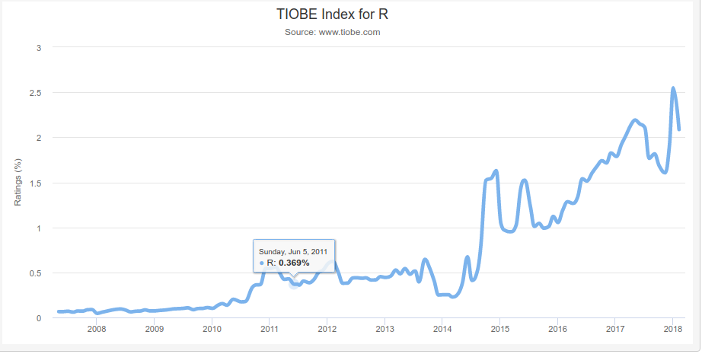
Introduction to R Programming R popularity
Stack Overflow:
1,384,157 questions tagged [java]
910,530 questions tagged [python]
226,678 questions tagged [r]
77,523 questions tagged [matlab]
Source: www.stackoverflow.com
TIOBE index:
1st place: Java
13th place: R
18th place: Go
Source: www.tiobe.com

Slide 8
Introduction to R Programming Feature overview
Many statistical and graphical techniques available out of the box or with additional packages
Linear and non-linear modeling, statistical tests, time-series analysis, classification, clustering, machine learning
Graphics (static, dynamic, interactive)
Data source connectivity (ODBC, JDBC)
Lots of packages at Comprehensive R Archive Network (CRAN)

Slide 9
Introduction to R Programming Live demo
Vectors
Matrices
Lists
Factors
NA, NaN
Subsetting
Functions: *apply (apply, lapply, sapply, mapply, tapply), split

Slide 10
Introduction to R Programming Live demo
Built-in datasets
Load CSV
Connect to data source

Slide 11
Introduction to R Programming How to start
Download and install R
Download and install R Studio
https://cran.r-project.org/doc/manuals/R-intro.pdf
http://tryr.codeschool.com/
https://www.datacamp.com/community/open-courses/r-programming-with-swirl
Coursera course: https://www.coursera.org/learn/r-programming

Slide 12
Introduction to R Programming Interesting use cases
Exploratory data analysis
Load and clean data, analyse, build models, test hypotheses, create graphs...Satisfied? Good!
Datasets very large – R becoming slow? Learn and use advanced concepts
Efficient R Programming book http://shop.oreilly.com/product/0636920047995.do
Writing Efficient R Code course https://www.datacamp.com/courses/writing-efficient-r-code
Still not enough?
Develop models using smaller sets in R, then implement models in fast compiled languages before running against full datasets.
Or have a look at more scalable enterprise-grade solutions – see next slides

Slide 13
Introduction to R Programming Integrating R with other technologies
Renjin – JVM based R interpreter
Can run R code from within Java code using standard Java Scripting API
dependencies {
compile "org.renjin:renjin-script-engine:0.8.2527";
}
...
RenjinScriptEngineFactory factory = new RenjinScriptEngineFactory();
ScriptEngine engine = factory.getScriptEngine();
engine.eval(new java.io.FileReader("script.R"));
Other libraries for bridging Java and R:
Rserve, rJava

Slide 14
Introduction to R Programming Integrating R with other technologies
Distributed data stores and scalable highly available apps
Data sources
Java middleware / applications
Happy software engineers
Java – R bridge
R scripts
Happy business analysts
Arcane business domain model

Slide 15
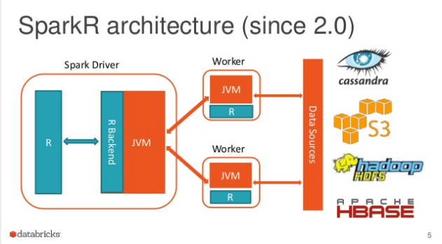
Introduction to R Programming Scaling out – SparkR
R package that provides a frontend to use Apache Spark from R.
Enables distributed processing, off-memory data structures
Source: https://www.slideshare.net/databricks/parallelizing-existing-r-packages-with-sparkr

Slide 16
Introduction to R Programming Enterprise’y solutions
Oracle Enterprise R
Part of Oracle Advanced Analytics Option
Can run R against data managed by Oracle database
Microsoft R Server
Enterprise class analytics platform based on R
Can integrate with Hadoop, Teradata, SQL Server
Based on Revolution Analytics – Big Data Analytics platform acquired in 2015 by Microsoft
Recently (Sep 2017) rebranded to Microsoft Machine Learning Server

Slide 17
Introduction to R Programming Thank you!

